Slide 1
Doubleknot for Education Programs
An Integrated Registrations and Reservations Solution

Slide 2











About Doubleknot
Designed specifically for admission-based nonprofits
Supports education programs, special events, memberships, fundraisers and ticketing with online, on-site and mobile solutions

Slide 3
Modular Solutions
Choose the solutions you need:
Event management and program registration
Reservations management and facility rentals
Membership management
Online fundraising
Ticketing and admissions

Slide 4
Registration for Education Programs
Manage everything from a simple event to a complex program with different tracks and options
  Capacity management and waitlists
Required forms must be completed to submit registration
View registration and financial data at a glance
Print-at-home tickets, mobile tickets and check-in
Manage walk-ups and last-minute changes with Sales Station Mobile

Slide 5
Bookings and Reservations
Custom reservation process for every kind of booking
Online always-up-to-date availability calendar S
Set booking windows, blackout dates and more
Create custom packages with optional add-ons
Status reports and administrative booking calendar
Accept outstanding payments and last-minute changes with Sales Station Mobile
Turnkey services—Doubleknot will configure reservations to your specifications

Slide 6
Integrated Features
Custom registration and purchase forms
Early discounts, late fees, and custom payment schedules
Discounts, promotions and member benefits
Integrated donation request at every checkout
Automatic and scheduled communications
Mobile registration and ticketing
Mobile check-in, changes and payments
Reporting and analytics

Slide 7
Automatic and Scheduled Communications
Automatic communications include:
  Confirmations and receipts with ticket link
  Group or individual tickets
  Scheduled event reminders
  Billing notifications
  Calendar updates
Communications Center email:
  Send email to all registrants for any event, program or reservation
  Send targeted email to all the results of a saved query
  Newsletters and mailing lists
  Doubleknot follows all best practices and standards for volume email, and continually works with ISPs to ensure that we are a trusted email provider

Slide 8
Billing and Payment Options
Any registration and reservation can accept online payments, offline payments or both
Easy and secure payment by credit card, debit card, electronic check, PayPal Express and/or gift cards
Choice of providers
  Doubleknot’s turnkey merchant services
  Payment processor of your choice
  Integration with our preferred merchant services vendor
Automatically apply membership discounts, early discounts or late fees
Payment schedules with automatic billing reminders
Payment adjustments and refund processing
Add or update registrations and collect payment anywhere with Sales Station mobile app for iPads

Slide 9
Program and Group Visit Check-in
Individual or group tickets for fastest check-in
Free check-in app
Sales Station Mobile app
  Check in attendees
  Update registrations
  Accept payment for outstanding balances
Attendance is automatically recorded in Doubleknot for reporting and analytics

Slide 10
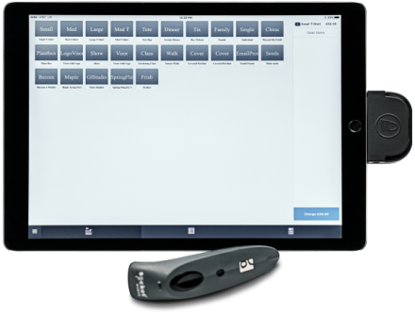
Sales Station Mobile for iPad
100% mobile solution
Program and event registration
Camp, class and event check-in
Update registrations and collect payment
On-site merchandise sales
Access to anything in Doubleknot
Attendance, updates and new registrations/reservations automatically recorded in Doubleknot

Slide 11
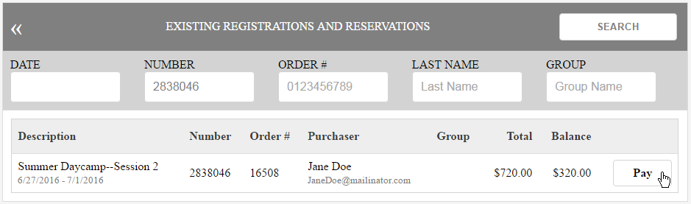
Collect Payment and Update Registration On-Site
Enter data or scan the receipt barcode to look up the registration
Update the registration
  Add more people
  Add more items like after-care, T-shirts or an additional session
Add any unpaid balance to the cash register
Collect payment by credit cadr
Doubleknot database is automatically updated with correct payment, registration and attendance info

Slide 12
Comprehensive Training and Support
Initial training
Unlimited email and telephone support for trained staff
Configuration review of anything you set up
Interactive webinars
Online help
Blog and weekly newsletter
Important system updates through Twitter

Slide 13
DEMO

Slide 14
Q & A

